Slide 1
Star Pizzas
Save the Galaxy with Pizzas!

Slide 2

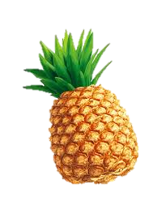
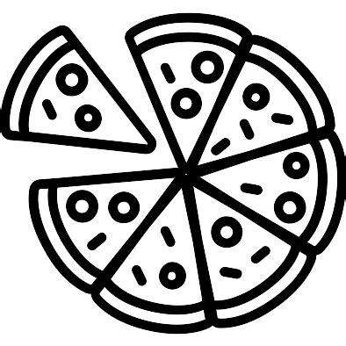
Splash Screen
Save the Galaxy with Pizzas!
Capitan Slice’s Mission
Avoid the pineapples
Defend Pizza Base from the big pineapples
Get 3 mozzarellas, 2 tomatoes and 1 basil.
Bring the goodies back to Pizza Base
Pizza Star Ship Ops
<- -> point PSS direction
^ shoot
[space bar] boosters
p Pizza Shield

Slide 3
Splash Screen Notes
Concept
Asteroid arcade game meets Pizza Making
Reference: https://youtu.be/WYSupJ5r2zo
Headline
Save the Galaxy with Pizzas!
Objects:
Pizza Base white, in the middle of the screen
Pineapple randomly entering the screen. Color-faded. No collisions
This part of Pizza Galaxy is a torus – when objects exit the screen they re-enter from the opposite side.
Treatment
Cartoon-looking icons
Vivid colors
Sound
SF-like music in the background

Slide 4




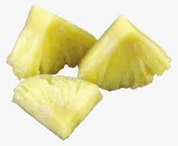

Playing Screen

Slide 5
Playing Screen Notes
Action
Use arrows to point the PSS
Pressing the space-bar the PSS accelerate progressively
To slow down and stop, need to rotate opposite direction and press bar again
Shooting and hitting a big pineapple will create 3 to five pineapple chunks
Hitting a pineapple chunk will make it disappear
To get the 3 mozzarellas, 2 tomatoes and 1 basil need to flyover them
The ingredient status is shown as faded / colored ingredients
Once 3 mozzarellas, 3 tomatoes and 1 basil are acquired, need to flyover to Pizza Base to complete the game
The three lives available are shown as three pizza slices
When the ingredients are acquired:
a sound is made
a headline is printed “Goodies on Board!”
the the PSS gets a glowing halo
pineapples start chasing the PSS (set on a collision course)
The PSS needs to get to base before base or itself are hit
Once PSS gets to base, the game is over

Slide 6
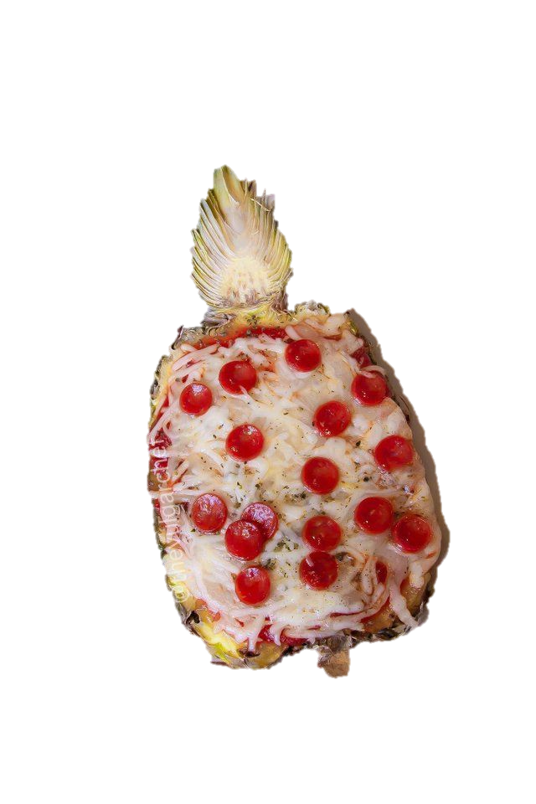
Game Over Screen - Winning
Don’t get desperate.
Try Again.
YOU can Make It!

Slide 7
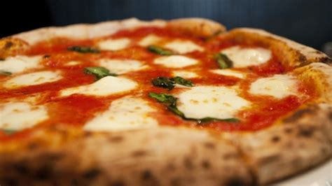
Game Over Screen - Losing
YOU Made It!

Slide 8




